Slide 1
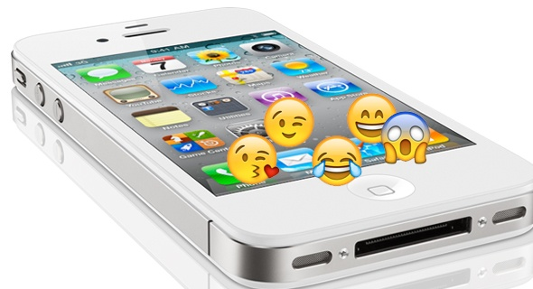
Project Introduction

Slide 2
Emoji-speak and titles
Task: You will be working with the hybrid text/visual format to portray both the title and author of your independent reading book as well as your own name. Requirements:
At least TWO ORIGINAL EMOJIS (thought of by YOU, not one on the current emoji list) to help represent either some part of your book’s title OR your book’s author OR your own name (digital image/clip art is acceptable).
Each original emoji needs to be accompanied by an EXPLANATION; why did you choose that image to function as a new emoji?
If it’s in the title of the book, how does that new emoji connect to the text (in terms of portraying a character, conflict, theme, symbol, etc.)?
If it’s in place of part of the author’s name, how does that new emoji reflect your tone toward the author/book (in terms of author’s writing style, ability to craft a story, etc.)?
If it’s in place of part of your own name, how does that new emoji reflect something about you as a reader? As a reader overall? As a reader of this novel? As the reader you are trying to become?
ONE OF THE TWO EXPLANATIONS MUST INCLUDE TEXTUAL EVIDENCE from the book to help illustrate the connection between the novel and your image.
Any other existing emojis from the list that you want to include are fine! No explanation needed. Just have the text-based translation, as portrayed through the models.

Slide 3
Title models

Slide 4
Emoji-speak book review directions

Slide 5
Like/dislike language help

Slide 6
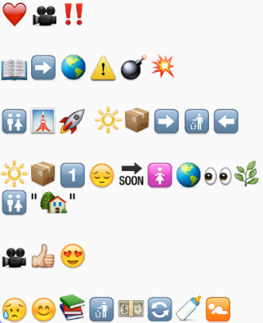
Condensed review models-yours will be about 1.5 pages
ALL TRADITIONAL TEXT:
I love the movie WALL-E! The story takes place after Earth's resources have been consumed. Humans have escaped the planet and started a new civilization in space, leaving behind a small, boxy, sun-powered robotic trash compactor named WALL-E to condense the mess made by humanity. WALL-E is productive, but lonely until a robot named Eve comes to Earth looking for evidence of new life on the planet in the hopes of humanity finally being able to, as the Captain declares, “Go home” (Stanton). This film is visually and thematically compelling. It provokes both tears and happiness and prompts serious intellectual considerations of consumption, commerce, connection, and creation.
ALL EMOJI TEXT/SPEAK:

Slide 7
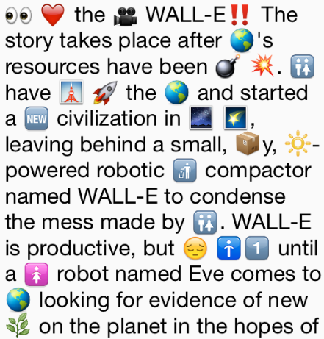
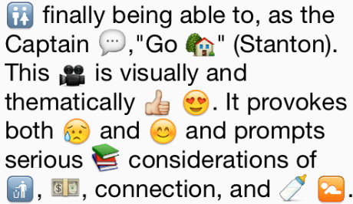
Condensed review model-yours will about 1.5 pages
HYBRID OF TRADITIONAL AND EMOJI TEXT:
Remember that in addition to the hybrid text/visual review, you will need to submit a typed, word-only version of your review so I don’t have to guess what emojis stand for. Or, you can double space your review as you create it, print it, and then just write the actual word above the image.

Slide 8
Annotated model of an abbreviated review
Assertion of overall evaluation of the novel
Context/descriptive summary of the novel
Properly-cited textual evidence from the novel (NOTE: need at least 2 pieces of evidence)
Evaluation of likes/dislikes/impact based on discussion of literary components such as, in this model, thematic ideas and theme (NOTE: model is incomplete – coverage of these aspects must be much more extensive and developed)

Slide 9
Checklist—have you met requirements?
“Create” Two New Emojis:
1st original emoji - circle the place where you put one: title author student name
Written/text translation for 1st emoji
Explanation for your 1st original emoji, illustrating novel/emoji connection
2nd original emoji - circle the place where you put one: title author student name
Explanation for your 2nd original emoji, illustrating novel/emoji connection
Written/text translation for 2nd emoji
Textual evidence that is properly-cited included in at least one explanation
Hybrid Book Review:
1 ½ typed, double-spaced pages
Hybrid/mixture of both words (text) and emojis (visuals)
1-2 sentences of narrative/plot summary
Thorough explanation of “likes” regarding the novel
Thorough explanation of “dislikes” about the novel
Includes 1st piece of properly-cited textual evidence.
Includes 2nd piece of properly-cited textual evidence.
Brackets/annotates/labels parts of the review
Includes a word/text only translation to pair with the hybrid

Slide 10
Rubric

